Slide 1
Hominid Biological Evolution

Slide 2
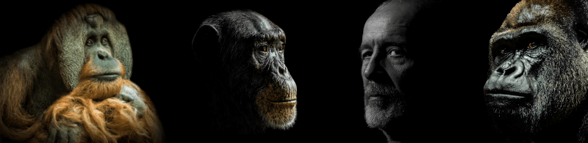
Objectives
In this Smart Lesson you will learn that humans are classified in the same taxonomic family as the great apes. The species within the family are differentiated by DNA nucleotide sequences, which brings about differences in:
relative size of cerebral cortex (brain)
mobility of the digits
locomotion - adaptations to bipedalism and quadrupedalism
prognathism (jaw structure) and dentition

Slide 3
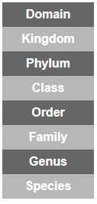
Taxonomy
Organisms are classified into groups based on common features.
There is a hierarchy of levels from least to most specific:

Slide 4
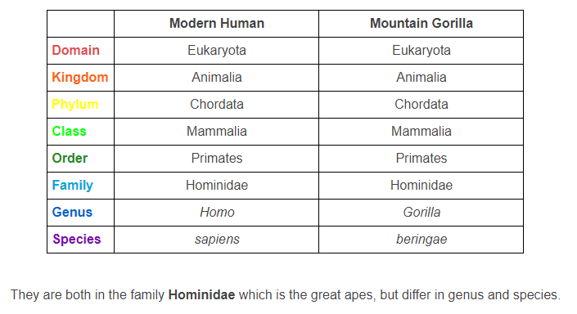
Compare the classification of humans with another great ape, the gorilla:

Slide 5
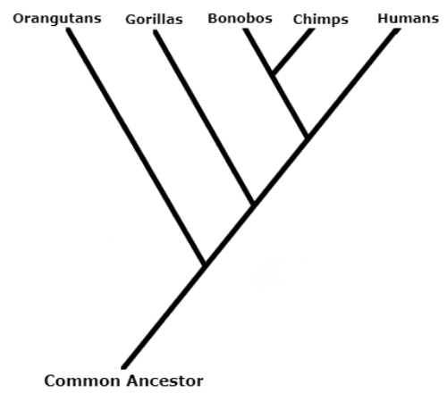
All great apes (family hominidae), including gorillas, chimpanzees, orangutans, bonobos and humans, share many key features and have large similarities in their DNA sequences, suggesting a common ancestor. There are, however, some differences.
Over time they have evolved differences in their biological features and behaviours.

Slide 6
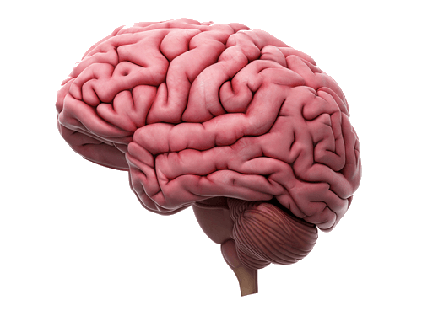
Hominid Brains
Today the human brain is larger and has more infoldings than any other great ape.
The cerebral cortex has many important roles in communication, memory, consciousness and thought. The increasing size and complexity of this region allows development of these skills.

Slide 7
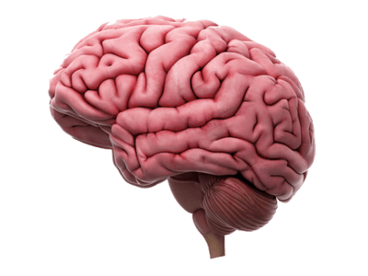
Throughout human evolution, the brain changed greatly.
These changes were in two areas:
• Size of the brain
• Organisation of the brain

Slide 8
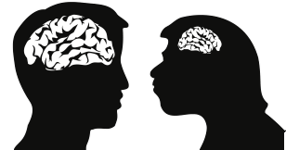
The trend shown in brain size is to increase over a period of time.
When the Homo sapiens brain size is compared to the brain size of earlier hominins, such as Homo erectus, it is apparent that the Homo sapiens brain is much larger.
(hominid=great ape, hominin= modern humans and their ancestors)

Slide 9
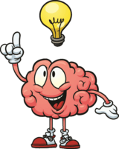
The organisation of the brain is directly linked to the efficiency and output.

Slide 10
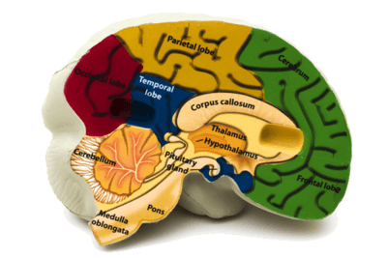
The amount of cortical tissue in the human brain is much greater than in other species of hominin.
The cortical tissue is the outer tissue of the brain - otherwise known as the cerebrum.
This part of the brain is associated with higher brain function such as abstract thought and action.

Slide 11
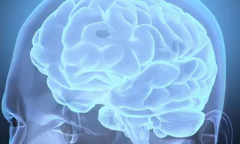
However, it needs to be noted that there are other mammals with larger brains than Homo sapiens, showing that the efficiency of the brain is not solely linked to the size of the brain, but also to the organisation and number of connections within the brain itself.

Slide 12
There are 3 significant changes within the brain that have changed its organisation:
• | Increased cortical tissue;
• | More infolding;
• | Greater development of Broca's and Wernicke's area (communication)

Slide 13
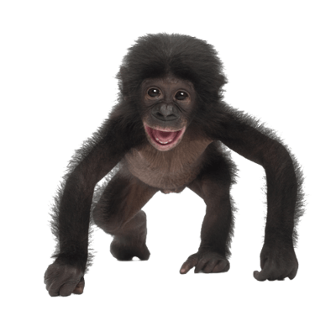
Digits
The shape and anatomy of the hand has altered greatly throughout the evolution of hominids.
Apes are capable of bipedal locomotion, however, their primary locomotion is knuckle-walking, meaning that their hands aren't free during locomotion.
This means that ape hands are adapted to aid in locomotion rather than manipulating objects.

Slide 14
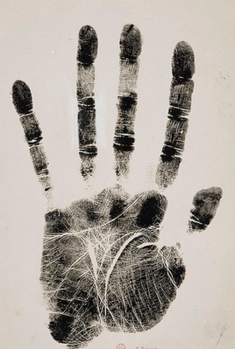
Ape hands are much larger than those of Homo sapiens, however they are capable of much less.
Both apes and humans have the ability of a power grip - where the hand grasps around an object. However apes lack the precision grip that defines hominin hands.
Apes have curved phalanges - the digital bones of the hands - to aid in brachiation (swinging in trees), further making the handling of small objects difficult.

Slide 15

The hands of Homo sapiens are the most advanced among hominids.
Whereas apes require their hands for locomotion, human hands are rarely used for this task, instead being primarily used for the manipulation of objects. This has resulted in the human hand being specialised for precision.

Slide 16

To allow the specialised abilities of the human hand, the anatomy had to alter slightly.
The thumb is significantly longer, with greater mobility. The thumb of apes is opposable, however the human thumb has a greater opposability. Combined with the saddle joint, which allows the thumb to touch the fingertips, these enable the precision grip.
In humans the thumb is joined to the wrist by the "saddle joint", allowing the thumb to cross the palm and reach each of the fingertips. Apes are incapable of touching all four fingertips with their thumb.
In addition to this, hominin phalanges are straight, rather than curved, once more allowing greater dexterity.
A precision grip, combined with finer motor control and sensitive fingertips are the features of the hominin hand that enable them to manipulate small objects and truly make them remarkable.

Slide 17
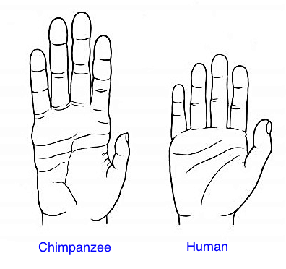
In summary:
Apes | Homo sapiens
Short thumb | Long thumb
Curved phalanges | Straight phalanges
Power grip | Power grip and precision grip
No saddle joint | Saddle joint
Less sensitive fingertips | Excessively sensitive fingertips
Clumsier motor control | Fine motor control
Long fingers | Shorter fingers

Slide 18

Bipedalism vs. Quadrupedalism
Becoming bipedal in humans meant that only the legs and feet were used in locomotion as opposed to other great apes which are quadrupedal.
This enabled hominins to use their arms and hands to carry items such as food or young.

Slide 19

Being able to carry items gave individuals an adaptive advantage over those that were unable to do so.
A greater chance of obtaining and collecting food combined with an ability to protect their young whilst travelling, gave the individuals a greater chance of survival, and therefore, a greater chance of passing on the bipedal genetics to offspring.

Slide 20

Standing upright evolved with bipedal locomotion. Less of the body is exposed to the sun, which helps with thermoregulation. Seeing over the grasslands may have enabled individuals to locate food or predators from a longer distance.
However, this may also have made them easier to be sighted by predators.

Slide 21
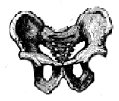
To accommodate the muscles associated with bipedalism, the pelvis is bowl shaped.
This creates a narrower birth canal. However, there is a large selection pressure in hominins towards a larger brain, therefore a larger skull.

Slide 22
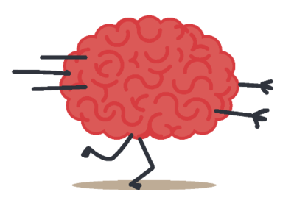
With a selection pressure for a larger brain, and a smaller pelvic inlet for more efficient locomotion, there is a trade off between having as large as possible birth canal, and a small enough pelvis for efficient locomotion.
A larger head, but smaller pelvis, can lead to birthing complications.

Slide 23
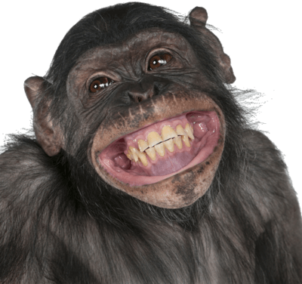
The shift to bipedalism has also led to increased risk of hernias (intestine protrudes through abdomen), slipped discs, flat-footedness and varicose veins.
Despite these disadvantages, the benefits, in particular of freeing up the hands, have led to selection pressures promoting the development of bipedalism.
Whilst none of the other great apes exhibit true bipedalism, many can demonstrate bipedalism over short distances, but differences such as in their pelvis and head position mean they are primarily quadrupedal.

Slide 24
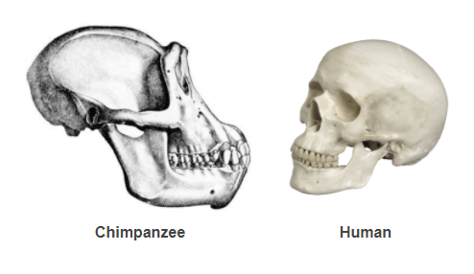
Prognathism and Dentition
Another key difference between humans and other great apes is the jaw.
Apes have a jaw that projects forward, known as prognathism, whilst humans have a flatter face. The difference is more obvious when looking at apes which diverged earlier from humans, such as gorillas and orangutans, whilst those that diverged more recently, such as chimps and bonobos, have a more flattened jaw, similar to humans.

Slide 25
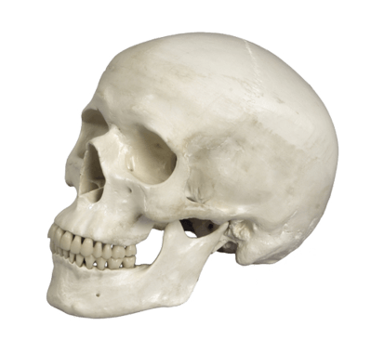
The prognathism (extent of protrusion) of the jaw decreased and facial angle became flatter with an increased steepness in the angle of the forehead to accommodate the larger brain.
The decrease in prognathism is mainly due to softer foods, meaning that large jaws for chewing tough plant material are not needed.

Slide 26
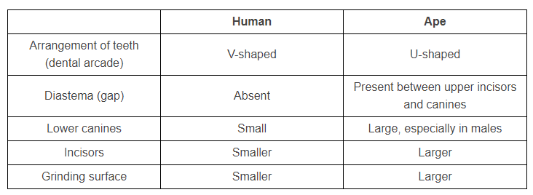
The changes in diet also led to changes in dentition.
Humans are omnivores and with the discovery of fire and cooking, tend to eat softer foods than other apes, which are primarily herbivores. This has led to several changes in teeth:

Slide 27
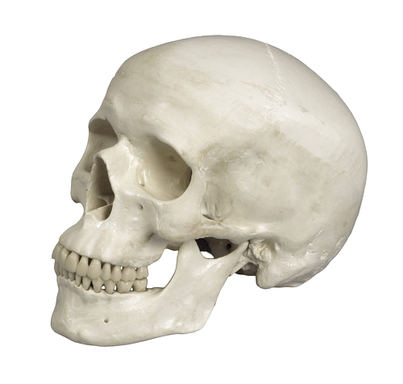
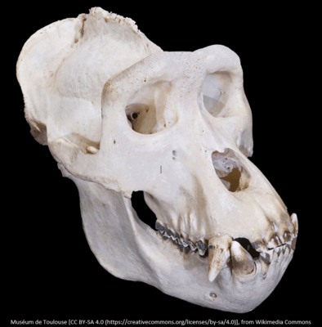
Comparison of human and ape dentition:

Slide 28
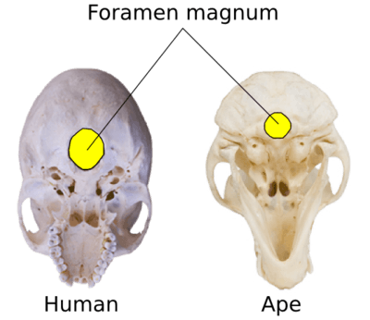
The main change in the skull due to bipedalism is the position of the foramen magnum.
The foramen magnum is the hole in the base of the skull through which the spinal cord passes.
In apes this is towards the back of the skull, whereas in humans the foramen magnum is underneath the base of the skull. This means that in hominins, the skull essentially balances on top of the spinal column, therefore it requires little muscular energy to support the skull over the centre of gravity.

Slide 29
This is different in apes, where they require large neck muscles to prevent the head from dropping forward. These strong neck muscles attach to large nuchal crests on the skull. Humans have no nuchal crest.

